Slide 1
Intro to Database Concepts & Design​
Prepared by Rouwa Yalda

Slide 2
What’s a database?
Database is a structured collection of data stored and accessed electronically.​
Database tables are like Excel tables; they consist of rows and columns: each column contains a different type of an attribute; each row corresponds to a single record.​
Digital databases are managed using DBMS which store database contents allowing data creation, maintenance and other access.​
DBMS stands for: Database Management System: is a software that operates a database storage, access, security, backup and other facilities. Commonly used DBMS: MySQL, PostGreSQL, Microsoft Access, SQL Server, Oracle …​
RDBMS (relational Database Management Systems) can manage storing the data using tables. Relation = Table​
​
The File Management System was used before the use of DBMS.​
the disadvantages of the FMS are: ​
unstructured data​
unorganized data ​
duplication or redundancy in data​
non –integrity of the data (data is not the same)​

Slide 3
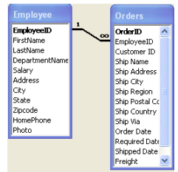
Types of Relationships in DB:
Many – to – one relationship:
Several types of relationships can be defined in database: one-to-many, many-to-many, and one-to-one relationships.
A many -to-one relationship is a relationship that is single valued in a direction and multi-valued in another direction:
Example 1: Employee can work in only one department, but a department can have different employees. Example 2: Employee can make many orders, but a single order refers to one employee

Slide 4
Many – to – one relationship:
The most common type of relationship is the one-to-many.
In a one to many relationship a record in Table A can have more than one matching record in Table B, but a record in table B has at most one matching record in Table A. An example of this would be Orders and Employees.
A single employee may have sold more than one order, but a particular customer’s order was sold by only one employee.
This type of relationship is created by including the primary key field from the table on the one side as an additional field (foreign key) in the table on the many side

Slide 5
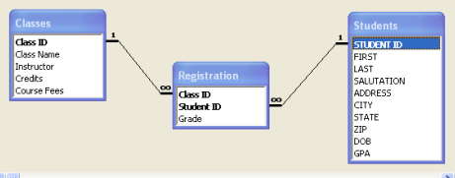
Many – to – many relationship:
A many -to-many relationship is a relationship that is multi- valued in both directions: Employee can work in many projects; a project can have many employees.
In a many-to-many relationship, a row in table A may have many matching rows in table B, and vice versa. An example of a many to many situation would be students and classes. One class has many students in it and likewise one student can have many classes.
A many-to-many relationship between tables is only possible by creating a third table (called a junction table) whose primary key consists of two fields – the keys from both Tables A and B.
To accommodate this situation, create a junction table containing the primary key from Table A and the primary key from Table B. Other pertinent fields may also be included in this table.
After you have created the junction table, you will then set the relationships by creating a one-to-many relationship between Table A and the junction table and between Table B and the junction table

Slide 6
One to one relationship
A one -to one relationship is a relationship that is single-valued in both directions: A manager manages one department; a department has only one manager.
This type of relationship is not common, because most information related in this way would be in one table. You might use a one-to-one relationship to divide a table with many fields, to isolate part of a table for security reasons, or to store information that applies only to a subset of the main table.

Slide 7
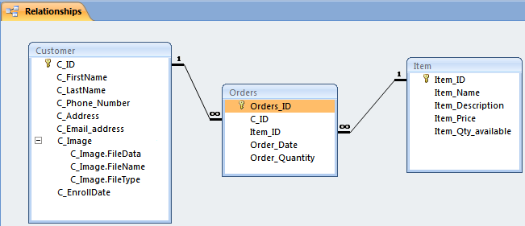
Another example of many to many relationship:

Slide 8
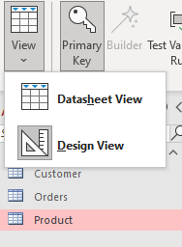
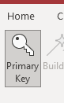
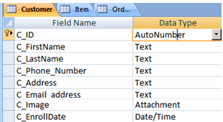
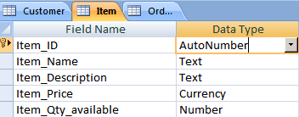
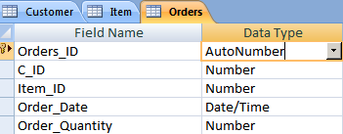
Exercise: Create a Database called OrderingItems.db , and create the following tables using design view:
Primary keys

Slide 9
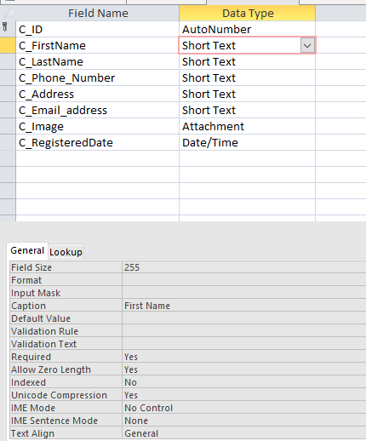
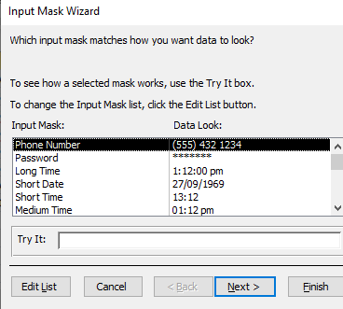
Setting Field Properties:
After you created the table Customer, : set the Customer_ID, the FirstName, the LastName, the phoneNumber, the Address, the email address , the RegisteredDate to “required field”.
Setting Field Properties- Input Mask for telephone number
In the customer table: choose the input mask of the TelephoneNumber to be: !\(999") "900\ 0000;;_

Slide 10
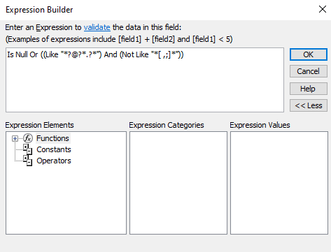
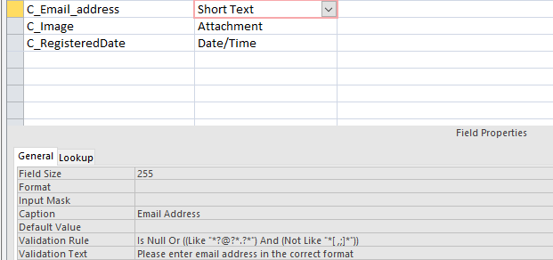
Setting Field Properties: validation rule for email address:
In the customer table: in the EmailAddress field, it is not accepted that the user to insert a space or comma or semi column; also you have this field to have at least 1 character before the “@”, at least 1 character between the “@” and the “.”, and at least 1 character after the “.”. In addition, this field must not be empty. To set the validation rule for the EmailAddress to the mentioned above, you write:
Is not Null Or ((Like "*?@?*.?*") And (Not Like "*[ ,;]*"))

Slide 11
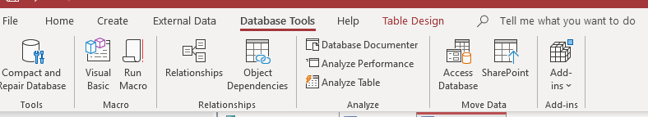
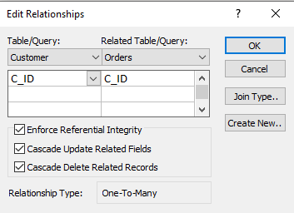
Relationships:
After creating table Customer, and table Item, and setting the field properties for both tables, it’s time to create the relationships between the tables:
Initially, this relationship was many to many relationship. In order to handle the data properly in the database, it will convert to 2 one-to-many- relationships with a junction table called Orders.
- Go to Database Tools> Relationships>Edit Relationships>Create New…
Set C_ID of the table Customer to be C_ID in the table Orders
- Enforce Referential Integrity , Cascade Update Related Fields, Cascade Delete Related Records.
=> In this way we are maintaining Integrity across the different tables, if a field is updated in one table, the update will be reflected in the other tables.

Slide 12
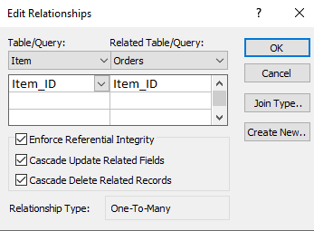
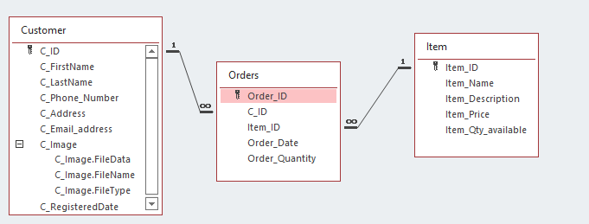
Relationships:
Similarly, set the Item_ID of the table Item to be Item_ID in the table Orders
- Enforce Referential Integrity , Cascade Update Related Fields, Cascade Delete Related Records.
=> In this way we are maintaining Integrity across the different tables, if a field is updated in one table, the update will be reflected in the other tables.
Now, you will have 2 one to many relationships:

Slide 13
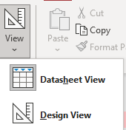





Fill the data in the tables using datasheet view:
Fields
records

Slide 14
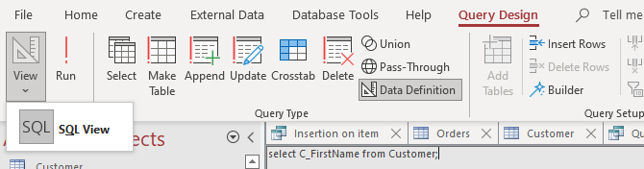
Creating Queries:
Create Query through Create> Query design
We can change the view to SQL view and then click Run button to run the query

Slide 15
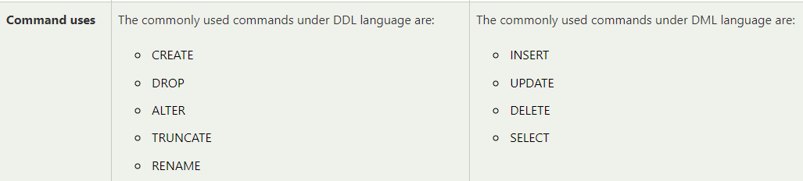
DDL Vs. DML
SQL stands for syntax Query Language.
There is SQL syntax for DDL (Data Definition Language) and another syntax for DML (Data Manipulation Language).
We have already created a database and created tables and set the primary key and foreign keys constraints using the UI, however we can do that using SQL DDL code.
Main difference between DDL and DML syntax code is:
For More information, visit: Difference between DDL and DML - javatpoint

Slide 16
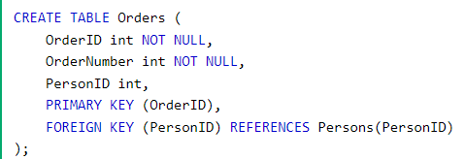
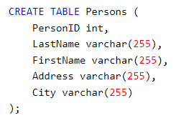
Examples of DDL syntax for creating a table with primary key and foreign key constraints:
For more information, please visit: https://www.w3schools.com/sql/sql_create_table.asp

Slide 17
Simple SQL queries- DML
Given: I want to see the firstnames of all the customers.
Solution: select C_FirstName from Customer;
Given: I want to get the name of the item whose ID=1.
Solution: select Item_Name from Item where Item_ID=1;
Given: I want to get all the information from the table orders.
Solution: select * from Orders;

Slide 18
Use of wildcard:
By default the wildcard in access is *, unless you change it to % to match the SQL syntax in SQL server:
Given: I want to see the names of all the items that contain the word ‘drawer’ but not sure if there is a letter/word before or a letter/word after.
Solution: select Item_Name from Item where Item_Name like ‘*drawer*’;

Slide 19

Insert Query:
Given: I want to insert a new item desk lamp,which is used in offices that costs $20, having the qty:3.​
Solution: Insert into Item(Item_Name, Item_Description, Item_Price, Item_Qty_available) values ('Desk Lamp', 'Used in Offices', 20.00, 3);​
It's advisable to use single quotes, not double quotes when inserting values in a table since double quotes might cause errors.​
Notice here I haven’t inserted the Item_ID since it is set to autoNumber which is an automatic Number set by the system. You don’t need to insert it manually

Slide 20
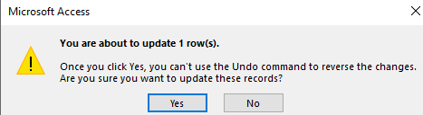
Update Query:
Given: update the table customer, set the lastname of the customer- whose id is 2- to Omar.
Solution: update Customer set C_LastName=‘Omar’ where C_ID=2;

Slide 21
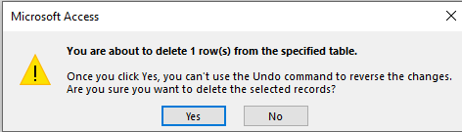
Delete Query:
Given:Delete the record of the item whose id is 7
Solution: Delete from Item where Item_ID=7

Slide 22
Queries that use Aggregate functions:
Aggregate functions are: sum( ), min( ),max( ), count() , and avg( ).
Given: How many orders do I have?
Solution: select count(Order_ID) as Count from Orders;
Given: What is the maximum order quantity?
Solution: select max (Order_Quantity) as max from Orders;
Given: What is the minimum order quantity?
Solution: select min(Order_Quantity) as min from Orders;
Given: I want to get the sum of all the order-quantities for the item whose ID=1.
Solution: select sum (Order_Quantity) as sum from Orders where Item_ID=1;
Given: I want to get the average of the order-quantities for the item whose ID=2.
Solution: select avg (Order_Quantity) as average from order where Item_ID=2;

Slide 23
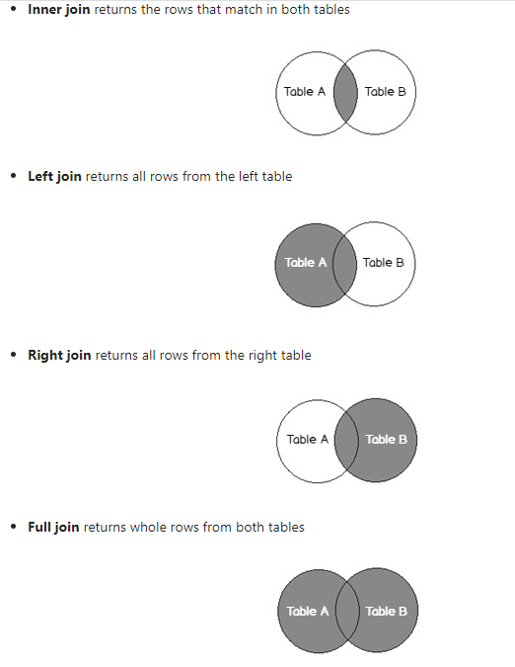
Types of joins:

Slide 24

Queries that use Inner Join:
Given: I want to get the Item_Name for the order number 1.
Solution: select Item_Name from Item INNER JOIN Orders ON Item.Item_ID=Orders.Item_ID where Order_ID =1;
Given: I want to get the Name of the all the customers that ordered the Item 'tv table';
Solution: select C_FirstName from Item INNER JOIN (Customer INNER JOIN Orders ON Customer.C_ID = Orders.C_ID) ON Item.Item_ID = Orders.Item_ID where Item.Item_Name='tv table';
It's always advisable to look at your database when you write these queries.

Slide 25

Select/Group By:
Given: I want to count the number of the orders grouped by each customer name.
Solution: select C_FirstName, count(Order_ID) as count from Customer INNER JOIN Orders ON Customer.C_ID=Orders.C_ID group by C_FirstName;

Slide 26

Select/Group By:
Given: I want to count the number of the orders grouped by each customer name. Sort the data by the descending order of the number of Orders.
Solution: select C_FirstName, count(Order_ID) as count from Customer INNER JOIN Orders ON Customer.C_ID=Orders.C_ID group by C_FirstName order by count([Order_ID]) desc ;

Slide 27

Select/Group By/having:
Given: I want to see the names of the customers who placed more than 1 order, grouped by the number of Orders they made.​
Solution: select C_FirstName,count(Orders.Item_ID) as count from Customer INNER JOIN Orders ON Customer.C_ID=Orders.C_ID group by C_FirstName having count(Orders.Item_ID) >1;

